Slide 1

PACT:
Police Autism Community Training
Notes:
Welcome
Introductions:
Colleen Jones, PACT, trainer/volunteer
WATCH: video
https://www.pactautism.com/

Slide 2




Our Team
“EDIT SLIDE BASED ON PRESENTERS”
Dr. Abigail M.A. Love
Director & CEO
Dr. Kirsten S. Railey Associate Director
Ms. Colleen Jones
Trainer & Volunteer
Adenike Gonçalves Kirby Intern
PACT: Police Autism Community Training
PACT-AUTISM.COM
Notes:
Leaders in PACT: Dr. Abbey Love, Dr. Kirsten Railey, and me.

Slide 3

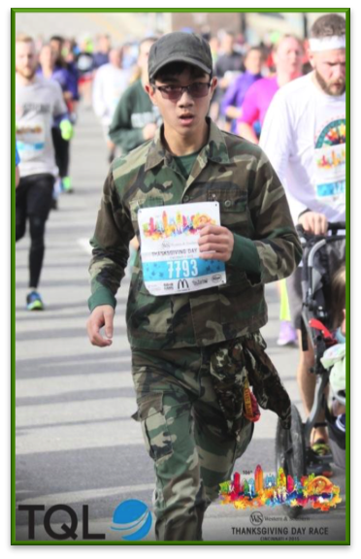
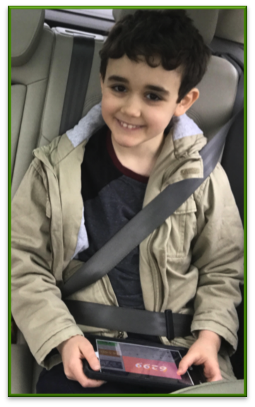
Our Roots
Notes:
How did PACT get started? The founder’s younger brother was playing in the woods. The other found has a son with ASD. Note: Rather than focusing on others’ family, I would choose a picture of my son and perhaps a co-trainer’s friend of family member. As in, “How did I get started in this work?”
Does anyone have a friend or relative with autism? What is your experience?

Slide 4


Why Are We Teaching This?
“In these types of calls for service, it is a top priority for our officers to de-escalate the situation by staying calm, minimizing distractions, decreasing outside noises, exhibiting patience, and displaying genuine concern in helping the person in crisis.”
– 2024; Baltimore Police Department
“Despite the rise of people diagnosed with autism, explicit training for law enforcement to respond to people with developmental or intellectual disabilities is still rare. Misunderstandings between officers and people with disabilities can lead to tragic consequences.”– 2025; PBS News Hour
“With so many individuals and families living with ASD, it is important that emergency responders have awareness and training on how to interact with an individual with autism..”
– 2024; National Volunteer Fire Council
Notes:
Updated 2021 note: suggest this slide be updated to fit local context – was there anything in the local area that is of interest? Are we training a specific group of first responders ? If yes, update with things in the news for that group specifically.
Why are we teaching this subject to police departments across the nation?
Has anyone experienced an encounter they would like share?

Slide 5

Today’s Agenda
**Pre-Survey**
• Definition & History of Autism
• Characteristics of Autism
• Strategies
• Resources
**Post-Survey**
Notes:
Today’s agenda:
• We started off with a pre-survey of what you know, give us feedback
• Then we’ll cover the history and definition of Autism
• Strategies and resources used by police officers to communicate with those on the spectrum

Slide 6

Today’s Agenda
**Pre-Survey**
• Definition & History of Autism
• Characteristics of Autism
• Strategies
• Resources
**Post-Survey**
Notes:
First topic we will cover today will include the definition and history of Autism Spectrum
Keep an open mind. Do not become jaded.

Slide 7

Autism
Different terms you may hear for the same neurodevelopmental difference
• Aspergers
• Autism Spectrum Disorder (ASD)
• Autistic
• Asperger’s/Asperger syndrome
• Neurodivergent
• On the Autism Spectrum
• Pervasive Developmental Disorder (PDD)
Notes:
Have a discussion around language. Talk about neuro-affirming language, neurodiversity, autism, ASD, etc. Depending on the class size, talk more specifically about the history of the movement. Also advise the first responders that they should be aware of the language the individual or their family prefers and there is not a single “right” choice.

Slide 8
Autism
Causes differences in the way the brain processes information
Affects how individuals use and understand language to interact and communicate with people
Is a ‘hidden’ disability for some - has no physical characteristics
Not a mental illness - a developmental disorder
Known as a spectrum disorder - a wide range of symptoms and their severity
Knows no bias – affects all races, ethnicities, socioeconomic groups
1 in 31 (3.2%) as of 2025 – cdc.gov
Notes:
Autism Spectrum Disorder
• Some people’s brains are wired differently. This causes differences in the way the brain processes communication, human emotion, and social interactions.
• Most behaviors of ASD are seen by age 3.
• There may be no apparent physical characteristics, but it may be shown through one’s behavior
• Seizures are often a co-morbidity
• 70% will have a co-morbid diagnosis of moderate to severe intellectual disabilities
• Autism effects all races, nationalities, socioeconomic groups
***Exists on a continuum:
Significant to mild attributes
Sometimes considered a “hidden disability”
2000 – 1 in 150
2006 – 1 in 110
2012 - 1 in 88
2018 – 1 in 44
2022- 1 in 31 (3.2%) children aged 8 years has been identified with ASD according to estimates from the CDC's ADDM Network
ASD is about 3.4 times more common among boys than girls—roughly 1 in 23 boys vs. 1 in 144 girls
The prevalence of ASD diagnoses is on an upward trend.
Experts point to multiple factors, including better screening and awareness, broader diagnostic criteria, and improved access to services, though research into environmental and genetic contributors continues

Slide 9
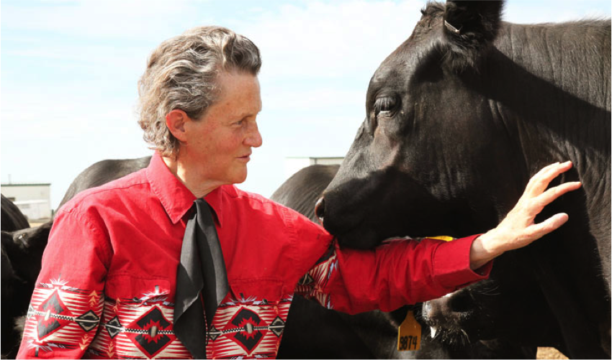
“Autism spectrum disorders are varied and no two individuals will manifest the same set of characteristics at the same level of intensity.”
-Temple Grandin “The Way I See It”
Photo by Rosalie Winard
www.pact-autism.com
Notes:
“If you have met one person with autism you have met ONE person with autism.” TRUE…BUT! Often this is our excuse as to why we cannot support Autistic people - because of the diversity and how you never meet two people the same. That is true. But that is not a reason to stop at learning the strategies and supports that can help people

Slide 10

Today’s Agenda
**Pre-Survey**
• Definition & History of Autism
• Characteristics of Autism
• Strategies
• Resources
**Post-Survey**
Notes:
Characteristics of Autism (pyramid graphic) When you encounter a situation with an individual acting strange, acknowledge it is strange behavior. Then ask yourself, is it drug? Is it mental illness? Could it be autism?

Slide 11
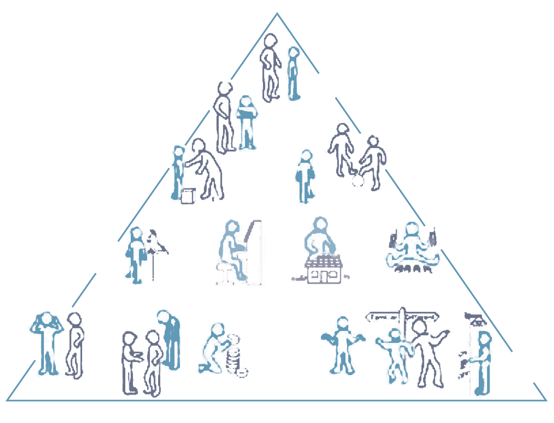
Triad of Characteristics
Notes:
When you encounter a situation with an individual acting strange, acknowledge it is strange behavior. Then ask yourself, is it drug? Is it mental illness? Could it be autism

Slide 12
A person on the autism spectrum may...
Look different | Wear unusual attire (e.g., shorts in winter, coats in summer, sound-reducing earmuffs or headphones)
 | Demonstrate signs of agitation (e.g., crying, screaming, pacing, clenching teeth, hand flapping)
 | Give little to no eye contact
 | Demonstrate repetitive actions (e.g., rocking, hand flapping, repeating the same phrase)
 | Have difficulty using correct voice volume
 | Self-harm (e.g., throwing themselves on the ground, hitting their head on a wall, smacking their face, biting their arm)
 | Carry object(s) for comfort, security, or communication (e.g., an iPad or book with picture cards)
 | Be sensitive or upset by lights, sounds (e.g., sirens), or by being touched
www.pact-autism.com
Notes:
Look Different
Read a few traits off pyramid

Slide 13
A person on the autism spectrum may...
Not understand social boundaries | Not respond appropriately to a uniform or badge
 | Repeat what you say or do, repeat phrases (e.g., from a TV show, etc.)
 | Stand very close to another person
 | Touch strangers
 | Be attracted to (and even reach for) badge, radio, keys, or weapon
 | Make rude or inappropriate comments (don’t take personally)
 | Have behavior misinterpreted by community members (Say inappropriate things to community members)
 | Not produce an ID when asked to do so
www.pact-autism.com
Notes:
Not Understand Social Boundaries
Read a few traits off pyramid

Slide 14
A person on the autism spectrum may...
Respond inappropriately or unusually to questioning | Not respond to requests/questions or take a long time to respond
 | Fail to make needs known (e.g., they are lost, hurt, etc..)
 | Appear argumentative, stubborn (not follow commands)
 | Ignore verbal questions
 | Respond after a long delay
 | Be unable to follow basic gross motor instructions
 | Black and white thinking - take things literally; doesn’t understand sarcasm or idioms
 | Talk about unrelated topics
www.pact-autism.com
Notes:
Respond Inappropriately or unusually to questioning
*Echolalia: A person may repeat everything you said in same tone, rather than answer a question. This is a characteristic of autism.
A person may respond “yes or no” without fully understanding the question you are asking
Read a few traits off pyramid

Slide 15
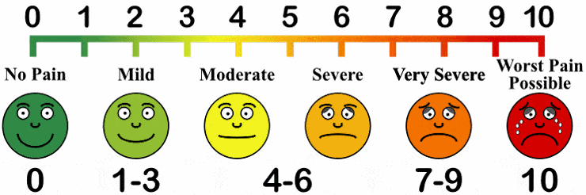
A person on the autism spectrum may...
Have a high/low (extreme) threshold for pain
www.pact-autism.com
Notes:
A person on the spectrum may have an extreme high or low
threshold for pain (smiley faces)
When would this knowledge be important?
Car accident, injury, other?
Now we will see videos, see what you can observe by
watching the two scenarios.

Slide 16
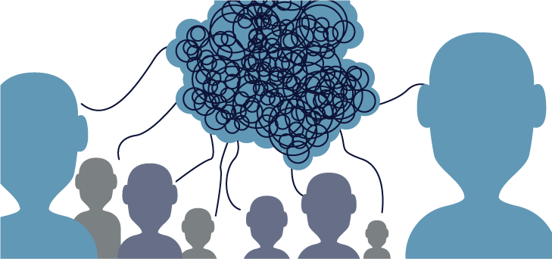
A person on the autism spectrum may...
Communicate differently or find it hard to communicate
Link to a Communication Example
As you watch...
Notice the patience, repetition, and calm voice of the caregiver.
Notes:
Notice the individual communicates with an electronic
device. (Do not separate him from his communication device)
He is not wearing a shirt. Some people are more comfortable
without scratchy clothing, i.e. person may wear shorts in
winter.
He is hungry and agitation subsides after eating chips.
https://www.youtube.com/watch?v=zO1euwFlPvo

Slide 17

Another Example: Arizona Police Body Cam
Link to Body Cam Video
ARIZONA
As you watch...
What characteristics of autism do you see?
Notes:
https://www.youtube.com/watch?v=uErofKXMwq0
Changed to body cam – need to decide how much – what to show
What is the individual holding?
Why is he walking by himself? Why not?
How did he communicate?
What did the bystander tell the officer?
I’m not here to tell you how to do your job. If you see
someone acting strange. Acknowledge that they are acting
strange, ask yourself, is it drugs? Is it mental illness? Is it
autism?
Slide 17 – Buckeye Arizona: Connor
· Replace with body cam footage and clip of stimming (sitting at table) from current link
· Direct suggestion from LMPD officer – media intro may be off-putting to many officers
· https://www.youtube.com/watch?v=FL5_ePqmH2Q from 18 seconds to 36 seconds

Slide 18
Another Example: Idaho Police Body Cam
Link to Body Cam Video
IDAHO
As you watch...
What characteristics of autism do you see?
Notes:
https://apnews.com/article/idaho-pocatello-autism-teen-police-shooting-88069c60a71f14cc95721f2f4809a86d
Changed to body cam – need to decide how much – what to show
What is the individual holding?
Why is he walking by himself? Why not?
How did he communicate?
I’m not here to tell you how to do your job. If you see
someone acting strange. Acknowledge that they are acting
strange, ask yourself, is it drugs? Is it mental illness? Is it
autism?

Slide 19
Ask yourself...
When am I most likely to interact with an individual on the autism spectrum?
Notes:
Approx half of individuals w autism will elope or bolt from a
safe environment
About 1/3 of those who elope are not able to communicate
their name, address, or phone number
*in online class: type response in the chatbox

Slide 20
Wandering & Elopement
Multiple studies confirm 50% of individuals with autism elope at least once, placing them at significantly higher risk of traffic injury (65%) and drowning (24%) – natonalaustismassoication.org
Wandering - Impulsively escape from home, school, or any setting, even with responsible supervision
May wander because
  Seek something: solitude, space to run, desired item (e.g., Coke from Wal-Mart), favorite place (McDonald’s), find a caregiver or a loved one
  Escape something: overwhelming noise, lights, crowd, excitement
  Their fight-or-flight nervous system has been activated by a change from their normal routine
  **Check water sources FIRST!
Notes:
Look carefully for medical ID tags, particularly if individual
is non-verbal
Person with ASD may perseverate on an object (McDonald’s
coke) or a location (local park or body of water). Check these
locations first depending on the person’s interest. This may
individual may travel straight to the location with no sense of
danger, i.e. walk across highways, or enter a lake when he
can’t swim.
May want to escape something: fire alarm, lights, crowd
About half of the autism community will elope or bolt from a safe environment
They are 8 times more likely to elope than their neuro-typical siblings
About 1/3 of those that elope are not able to communicate their name, address, or phone number

Slide 21
Other Encounters
Aggression
  May hurt themselves or attack caregivers when upset
  May have “meltdowns” and appear inconsolable at times
Unusual behavior
  e.g., walking for a long time with a blank look on the face, carrying an object that is age-inappropriate, intense interest in something others find mundane, inappropriate, or potentially dangerous (e.g., knife collection)
  Community and first responder misinterpretation of behavior
Notes:
Aggression: hurting themselves or attacking caregivers when upset
• may have “meltdowns” and appear inconsolable at times
Unusual behavior:
• walking for a long time with blank look on face, carrying an object that is age unexpected
• intense interest in something others find mundane or inappropriate or potentially dangerous
• Community and first responder misinterpretation of behavior
Meltdowns are NOT tantrums they are the person’s way of
saying, “I’m overwhelmed, I’m overstimulated, I’ve had
enough!” This person has to be given space, breathe, and yell
it out if necessary. You may see this in restaurants, public
transit, shopping malls, etc.
Inform prosecutor, judge, and/or other law professionals that the individual is autistic
If the individual needs to be incarcerated, segregate them from the general population
The need to carefully look for medical I.D. tags particularly if individual is non-verbal.

Slide 22
Other Encounters
Criminal Acts
  Important to take autism into account when booking an individual for a crime or misdemeanor
Medical Emergencies
  Seizures
Victims of abuse or other crimes
  e.g., bullying/harassment, assault, material objects taken, physical/sexual abuse by caregivers/teachers
Notes:
Inform prosecutor, judge, and/or other law professionals that the individual is autistic
If the individual needs to be incarcerated, segregate them from the general population
The need to carefully look for medical I.D. tags particularly if individual is non-verbal.

Slide 23

Today’s Agenda
**Pre-Survey**
• Definition & History of Autism
• Characteristics of Autism
• Strategies
• Resources
**Post-Survey**

Slide 24
Ask yourself…
Knowing communication is a challenge for individuals with autism, what can we do?
Notes:
Short sentences, simple words, calm voice.
Has anyone used strategies before that they’d like to share?

Slide 25
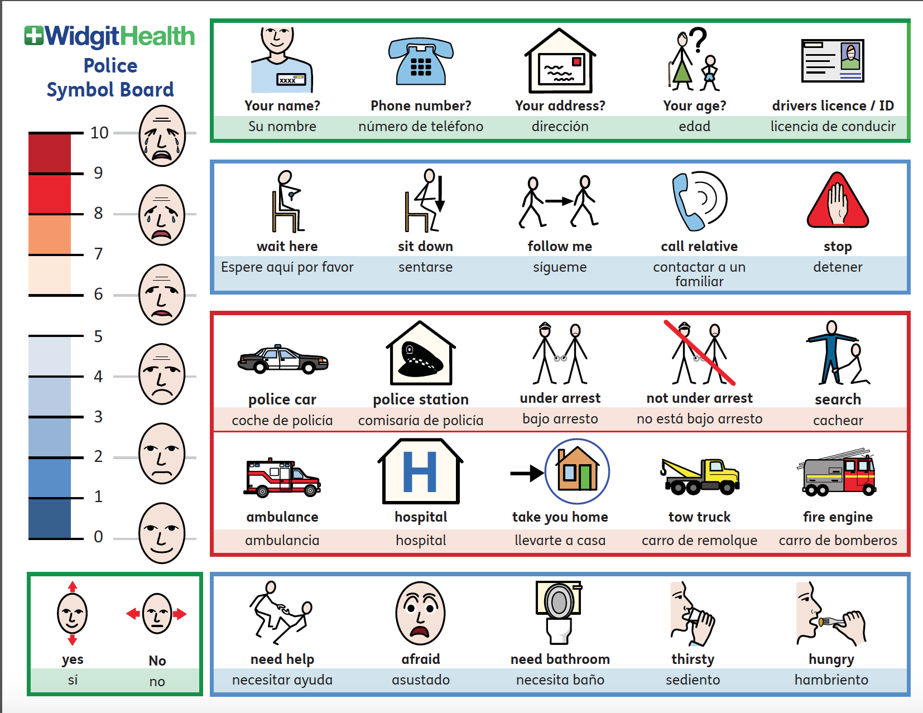
Use an Alternative Form of Communication
Notes:
Use an alternative form of communication: PECS pictures
Short sentences, simple words, calm voice.
*This can work for anyone under the influence, mental
illness, or one with autism.
**stop and work through with this – model, video, practice

Slide 26
Tips for Encounters
Contact caregivers and/or people who know the person well (e.g., siblings, teachers, or therapists if you work in school or other community settings)
Call ASAP and ask for suggestions for interacting with the individual with ASD
What are their likes or special interests?
How do they communicate?
What are their favorite places to visit?
Are they currently having a “meltdown?”
Notes:
Contact caregivers and people who know that person well
(siblings, teachers, therapists or other community settings).
Obtain imperative behavioral information from a caregiver
Are they currently having a “meltdown”?
Do they have a history of elopement? Self-injurious behavior? Physical aggression?
- If yes, ask if there have been strategies utilized that are generally effective
What soothes or calms the individual? Is there an object of comfort?
Is there anything to avoid saying or doing in front of the individual?
Is there a normal routine for them right now?
What are some things the individual is really good at?
How does the individual communicate? If so, then the device needs to go with them if they are transported

Slide 27
Ask yourself…
What other questions would you ask to caregivers if you called them in an emergency situation involving someone with autism?
Notes:
When were they last seen? What were they wearing?
But also:
What is his interest? Does he have a favorite song? A favorite
food? Toy/object? Favorite person?
Any chance he went towards water?
Who or What calms him? What agitates him?
*him still intended to be gender neutral
What else could you ask the caregiver?

Slide 28
Tips for Encounters
Talk in short, direct phrases and rephrase as needed
  “Sit down. Hands in lap. Tell me your name.”
Stay positive
  “Put your hands in your lap.” → Not: “Do not touch my badge!”
Use a calm, even voice
Look for an ID tag or a medical alert bracelet, especially if the individual is non-verbal
Be patient – allow adequate wait time
Consider the use of gestures or pictures
One person speaking at a time
Notes:
Talk in short, direct phrases and rephrase as needed.
• Stay positive
• Use a calm, even voice
• Look for ID, tag/medical alert bracelet esp is
individual is non-verbal
• Be patient- allow adequate wait time
• consider use of gestures or pictures
• one person speaking at a time
Use a soft, neutral tone of voice with neutral expressions
Use short, concise, specific directions
Use simple, direct language when asking questions
Allow extended time for responses
Only one person should be speaking to the individual at a time

Slide 29
Please be empathetic with every single conversation you have with persons with autism, parents, guardians, or caregivers.
Keys Things to Remember
Notes:
Odds are this person has been in a similar situation before,
and he/she knows best how to calm the individual down.
The caregiver may NOT want you to intervene but just to
be there. Please ask the caregiver before you intervene.

Slide 30

Calming a Situation
Try to avoid stressful or anxiety-inducing situations
DO NOT:
Interrupt repetitive behaviors (like pacing)
Touch the person unnecessarily
Try to remove items individuals may be holding (iPad, toy, comfort object)
Restrain, seclude (e.g., in the back of a police car), or attach things like handcuffs to the person if not absolutely necessary ( it may be traumatic and further escalate the situation)
DO:
Identify and remove stressors (loud sirens/flashing lights) or go to a quiet environment
Be mindful of facial expressions, body language, and other nonverbal cues that may communicate fear, worry, concern, or indicate that the person may be overwhelmed.
Notes:
Do Not:
• Interrupt repetitive behaviors (like pacing)
• touch the person unnecessarily
• try to remove items individuals may be holding (iPad,
toy, comfort object)
• Restrain, seclude, (e.g. in the back of a police car) or
attach things like handcuffs to the person if not
absolutely necessary (this may be traumatic)
Do:
• Identify and remove stressors or go to a quiet
environment (loud sirens/flashing lights)
• Be mindful of facial expressions, body language, etc.
that may be communicating fear worry, concern, or
show that the person may be overwhelmed

Slide 31
Ask yourself...
What strategies have you found to be effective in supporting autistic individuals and de-escalating situations?
What strategies were not as effective?
Notes:
Note: Do NOT assume that an individual with autism is
intellectually disabled. Many individuals with autism can be
very observant and sharp, even if they present as non-verbal.
How could you de-escalate a situation?

Slide 32
Ask yourself...
Tell, Show, Do | Creates a routine - makes interaction predictable
Behavioral Momentum | Start small and build up to tough requests or demands
Premack Principle | First/Then
Modeling | Show them what you need them to do or what you will do to them
Reinforcement | Let them know when they have done the right thing; give them something they like
Patience | Interactions will likely take longer - don’t rush the process
Physical Restraints | Only as a very last resort - give 2x the wait time before doing it --- BEWARE of positional asphyxia
Notes:
Give positive reinforcement. Start small and build up. Be
patient. Beware of positional asphyxia
I use,
“first...then....”
in my house

Slide 33
Medications
There are no medications specifically for autism.
Medication may be prescribed for:
Anxiety
Depression
ADD/ADHD
Seizures
Irritability, Aggression, and Self-Injurious Behavior
Notes:
There are no medications that directly relate to autism but
they may be used to treat co-morbidities such as anxiety,
depression, ADD/ADHD, seizures, etc.

Slide 34
Common Interventions and Support
Applied Behavior Analysis (ABA)
Speech-Language Therapy (SLT)
Occupational Therapy (OT)
Physical Therapy (PT)
Psychiatry
Counseling (Behavioral Psychologist)
Community Living Supports (CLS)
Employment Specialist
Cognitive Behavioral Therapy (CBT)
Social Skills Training
Pivotal Response Treatment
Notes:
Mention no cure, but lots of strategies, supports, therapies
Applied Behavior Analysis (ABA), Speech therapy,
Occupational therapy, Physical therapy, psychiatry,
counseling, community living supports, employment
specialist.
You don’t have to know these topics; you should just know
they exist.

Slide 35

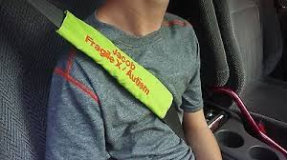
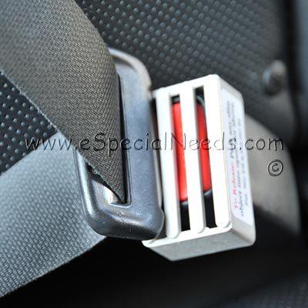
Big Red Safety Box & Seatbelt Locks
Proactive Strategies
Notes:
Big Red Safety Box and Seatbelt Locks

Slide 36
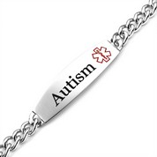
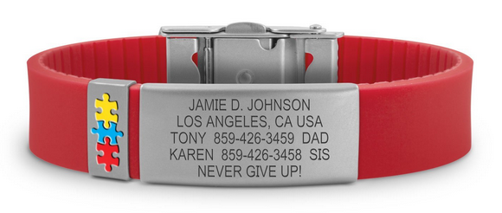
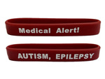
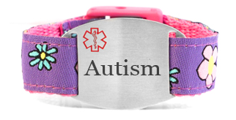
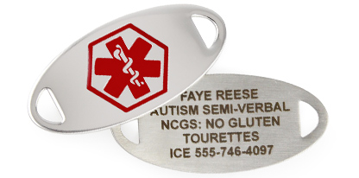
Medical Alert Jewelry
Proactive Strategies
Notes:
Medical Alert Jewelry

Slide 37
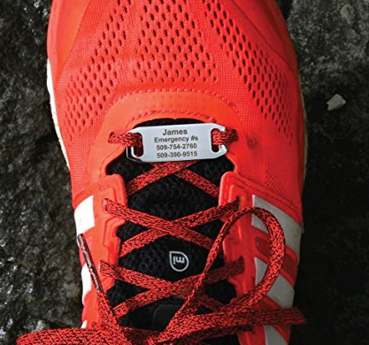
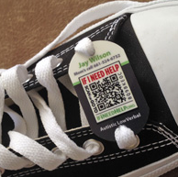
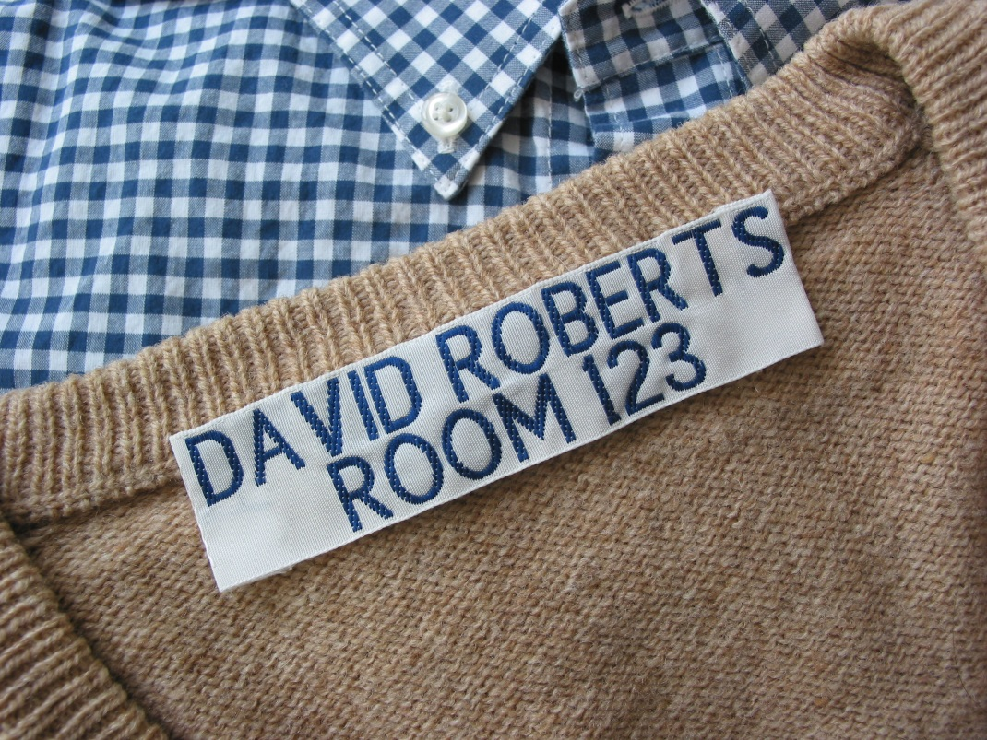
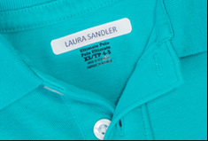
Shoe Tags and Clothing Identifiers
Proactive Strategies
Notes:
shoe tags and clothing identifiers

Slide 38
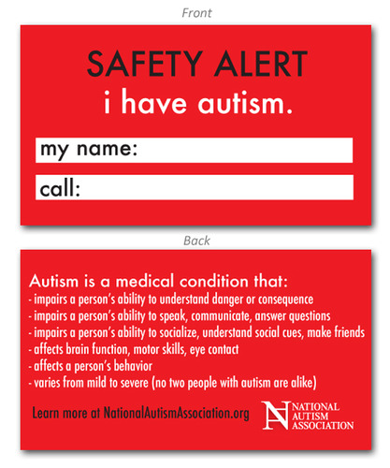
Information Card in Wallet/Purse/Bag
Proactive Strategies
Notes:
-information card in wallet/purse/bag

Slide 39
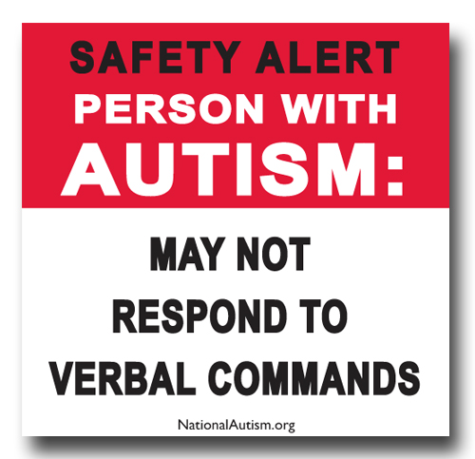
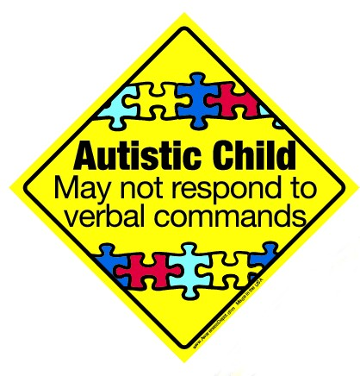
Car or House Stickers
Proactive Strategies
Notes:
car or house stickers

Slide 40
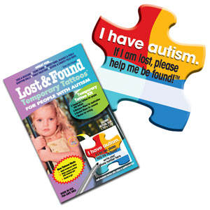
Temporary Tattoos
Proactive Strategies
Notes:
temporary tattoos
Many of these can be found on Etsy or other online retailers

Slide 41
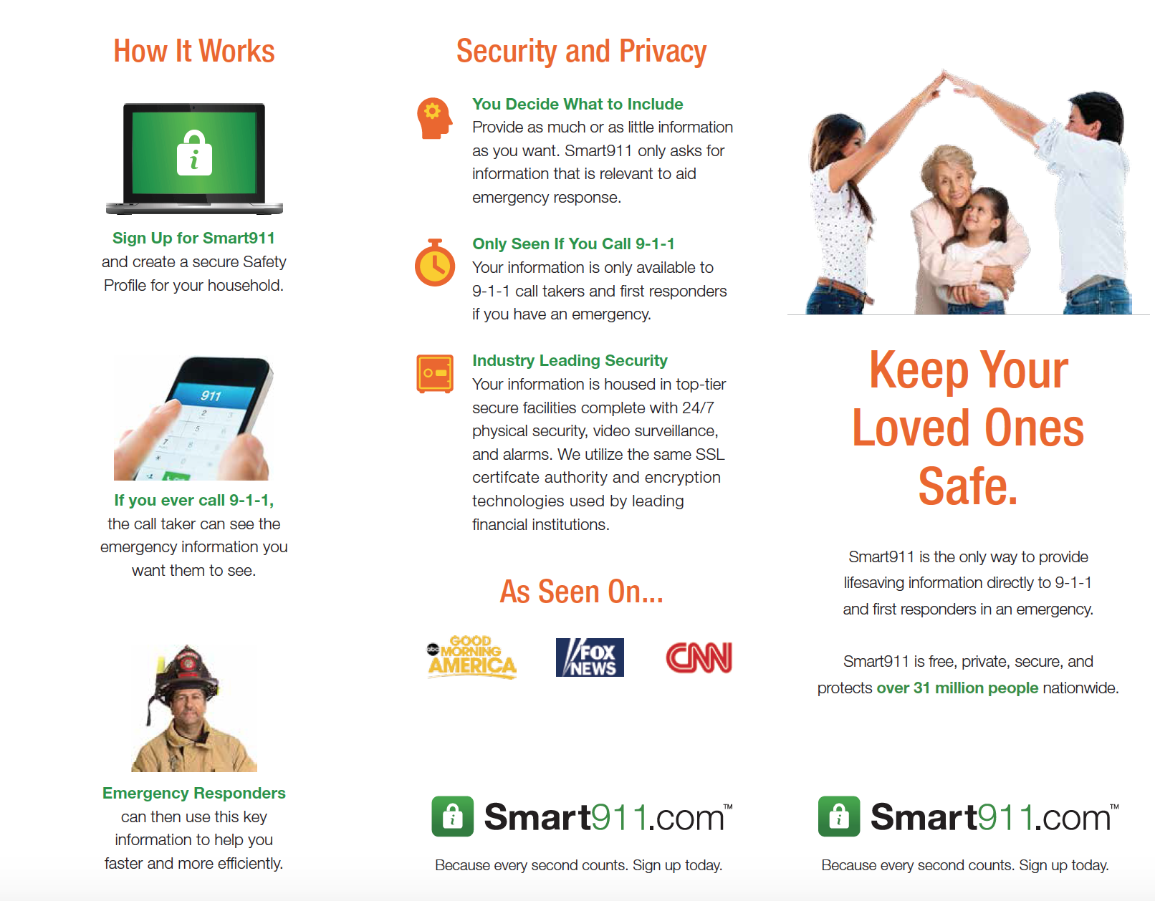
Proactive Strategies
Smart 911
Notes:
Smart 911
Voluntary program to pre-fill data about your house, people
in it, and things to be aware of in a rescue or emergency
situation.
Is this available in your community? Do you promote it?

Slide 42
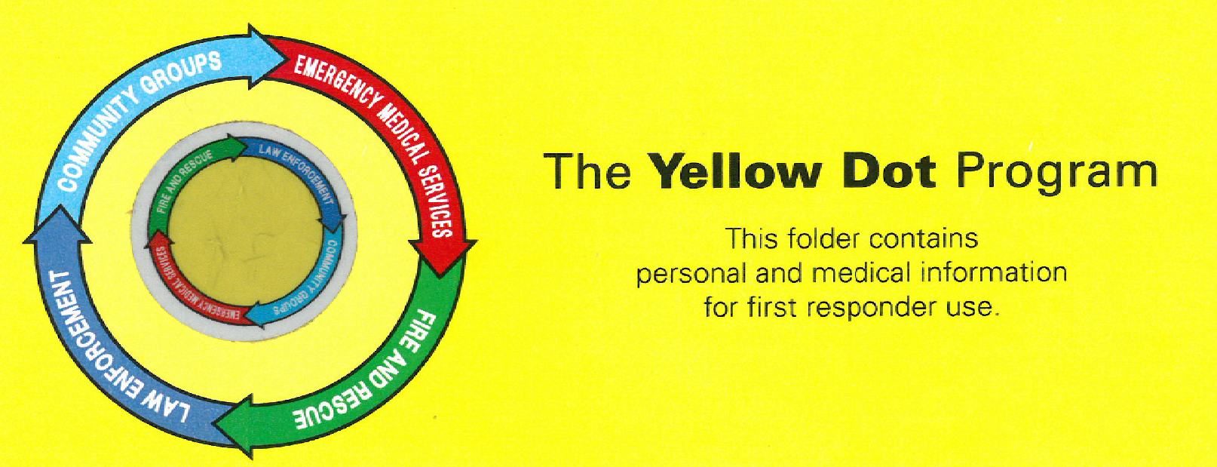
Proactive Strategies
Yellow Dot Program
Decal may be found in the lower left corner of the driver’s side rear window.
Folder should be found in the console or glove compartment of the vehicle
Folder may include a picture, all medical information, including PMHx, allergies, medication list, contact information for the personal physician, and emergency contact information
www.pact-autism.com
Notes:
Yellow Dot program
Decal can be found in the lower left corner of the driver side
rear window. A folder in the glove box can include a picture,
medication, allergies, emergency contact into, etc.

Slide 43

Today’s Agenda
**Pre-Survey**
• Definition & History of Autism
• Characteristics of Autism
• Strategies
• Resources
**Post-Survey**
Notes:
Who are your local advocacy groups?
Who is your community go to person?
Is there anyone in your department who is knowledgeable on
this topic?

Slide 44

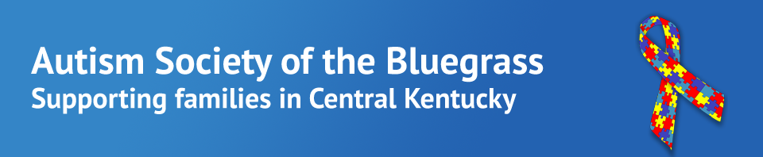
Know Your Local Resources
If families need further evaluation: Our Lady of Peace (Louisville) or the possibility of school evaluations
If an individual cannot be calmed: Call an ambulance (if self-harming or is not calming down)
If families need support: Provide information on local support group(s)
Notes:
Which of these resources are available in your department?
When would you work with the community to make these
available?
EDIT THIS SLIDE TO FIT LOCAL CONTEXT

Slide 45


PRACTICE
www.pact-autism.com

Slide 46
Scenario #1
Imagine a parent calls the police for help in her home. She is trying to calm her child with ASD who is having a meltdown and becoming aggressive towards her and damaging her home.
Tip:
Stay with the family as a calming influence while waiting out aggression

Slide 47
Scenario #2
You get called to help find a child who was last seen at school. She has been missing for over an hour.
Hint:
What questions will you ask the parent after learning the individual has ASD?

Slide 48
Scenario #2
You get called to help find a child who was last seen at school. She has been missing for over an hour.
Tip:
Ask for the child’s special interest, favorite areas, level of communication, and any possible triggers for a meltdown

Slide 49
Scenario #3
How do I use a visual support?
Role play video
by Jay and Vahl
Notes:
**additional scenarios added depending on size of group

Slide 50
Additional References & Resources
National Autism Association’s Safety Site
autismsafety.org
Contact With Individuals with Autism
www.autismriskmanagement.com/wp-content/uploads/2016/07/FBI_Law_Enforcement_Bulletin.pdf
Smart911
https://safety.smart911.com/tri-fold-brochure
NJ Disability Training for First Responders (State of New Jersey, 2008)
ASA- Autism Society of America
autism-society.org
AWAARE Collaboration by National Autism Association
Awaare.neationalautismassociation.org
ASBG – Autism Society of the Bluegrass
asbg.org
Autism and Law Enforcement: Why it Matters
www.autismalert.org/uploads/PDF/Autism-and-Law-Enforcement-WPJ
Notes:
Edit to fit local context
Additional Resources can be found at www.pactautism.com

Slide 51
Thank You!
PACT: Police Autism Community Training
pact-austism.com

